Slide 1


Bootcamp Day-1
by ThinkCloudly

Slide 2
Agenda...
What is Kubernetes?
Kubernetes in the ecosystem
Why Kubernetes?

Slide 3
What is Kubernetes ???
Container ‘Orchestrator’
Open-source project
k8s
DevOps tool

Slide 4
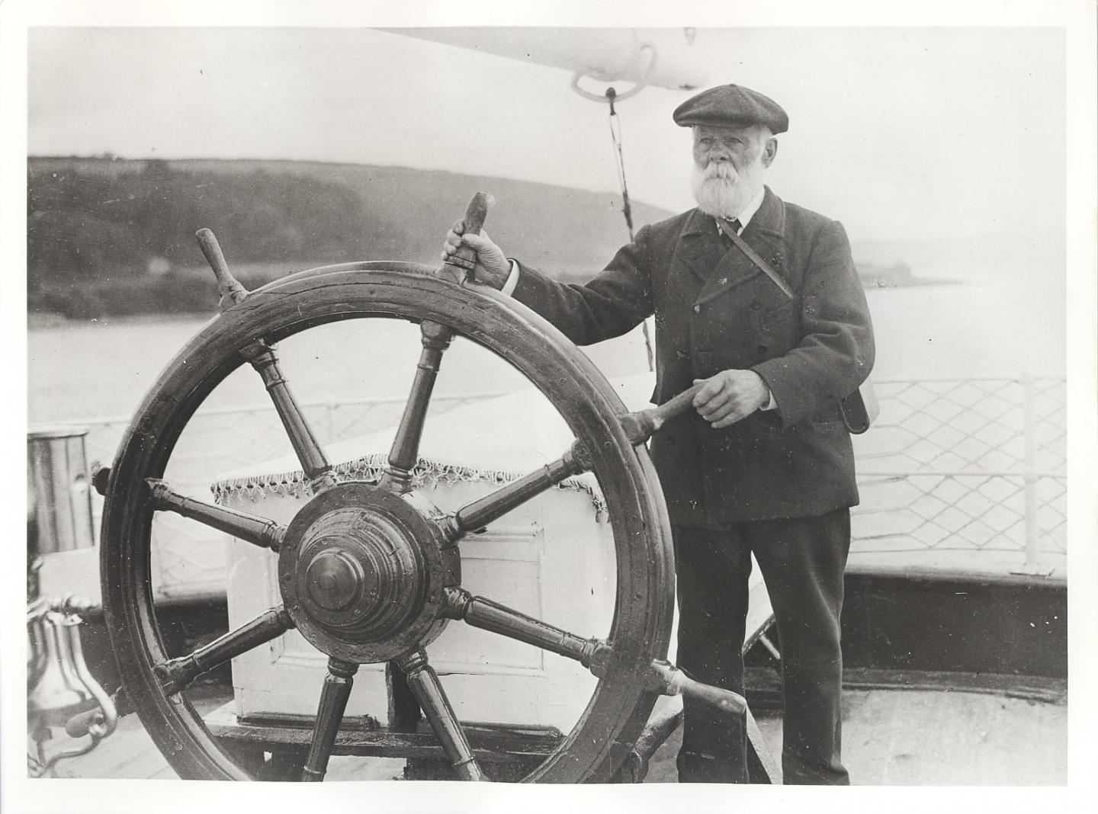
Icon looks similar to…

Slide 5
K8s in the ecosystem
Let us do some whiteboarding

Slide 6
Why k8s
Widely used in IT
Container runtime agnostic
Follow declarative configuration
Multi-cloud capability
Enhances priductivity
Portable and flexible
Free and open source

Slide 7
Thank You….

